Slide 1
Learning using Decision Trees
CSN-382

Slide 2

Plan for today
Remember: There is no “training” stage in the standard nearest neighbors (unless we are learning the feature of distance function from the training data)
The training data itself is the model that we need to keep at test time. Recall that NN is a memory-based or nonparametric approach
Wrap-up the discussion of nearest neighbors
How to speed-up nearest neighbors at test time?
Model/hyperparameter Selection
Learning with Decision Trees

Slide 3
Speeding-up Nearest Neighbors
Can use techniques to reduce the training set size
Several data summarization techniques exist that discard redundant training inputs
Now we will require fewer number of distance computations for each test input
Can use techniques to reduce the data dimensionality (no. of features)
Won’t reduce no. of distance computations but each distance computation will be faster
Compressing each input into a small binary vector (a type of dim-red)
Distance/similarity computation between bin. vecs is very fast (can even be done in H/W)
Various other techniques as well, e.g.,
Locality Sensitive Hashing (group training inputs into buckets)
Clever data structures (e.g., k-D trees) to organize training inputs
Use a divide-and-conquer type approach to narrow down the search region
We will look at Decision Trees which is also like a divide-and-conquer approach
Notes:
Divide and conquer approach to narrow down the search space includes building decision tree and using NN at leaf nodes.

Slide 4


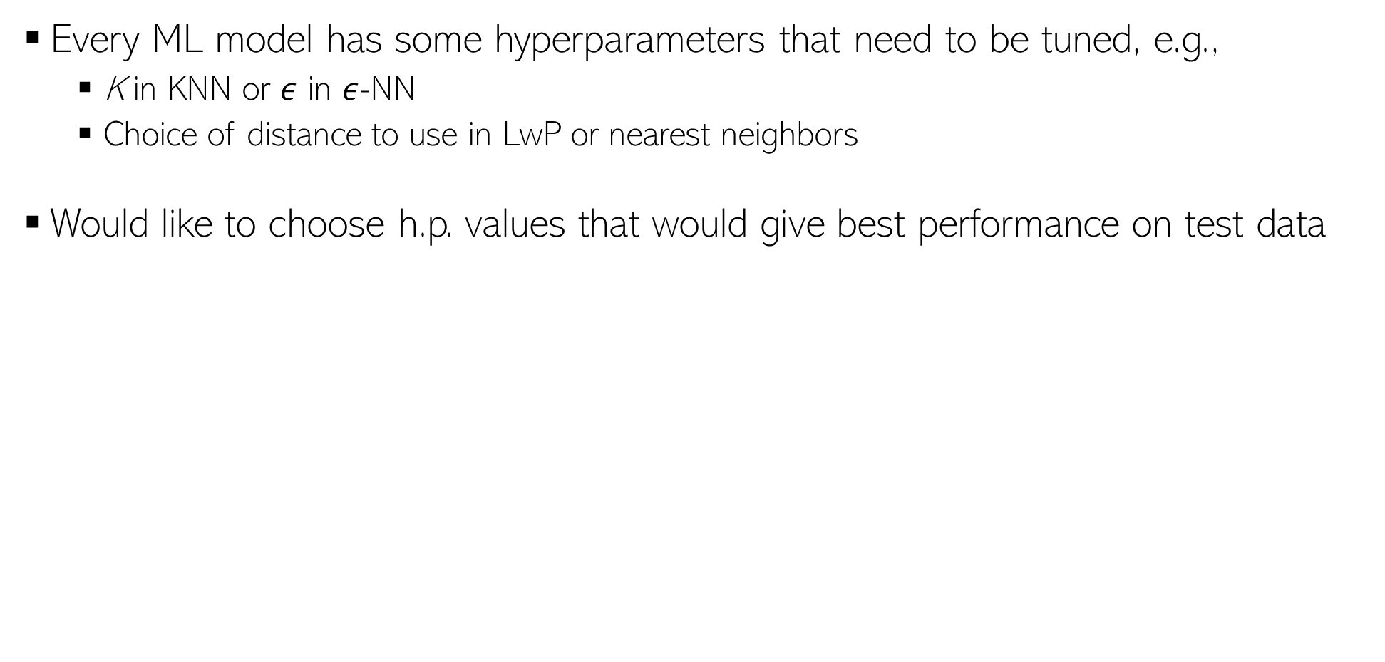
Hyperparameter Selection
Every ML model has some hyperparameters that need to be tuned, e.g.,
K in KNN or $ε$ in $ε$-NN
Choice of distance to use in LwP or nearest neighbors
Would like to choose h.p. values that would give best performance on test data
Oops, sorry! What to do then?
Okay. So I can try multiple hyperparam values and choose the one that gives the best accuracy on the test data. Simple, isn’t it?
Beware. You are committing a crime. Never Ever touch your test data while building the model
Use cross-validation - usea part of your training data (we will call it “validation/held-out set”) as test data. That’s not a crime. ☺
Is validation set a good proxy to test set?
Usually yes since training set and test sets are assumed to be similar (plus, you are careful in choosing your validation set)

Slide 5

Cross-Validation
No peeking while building the model
Training Set (assuming bin. class. problem)
Test Set
Note: Not just h.p. selection; we can also use CV to pick the best ML model (Model Selection) from a set of different ML models (e.g., say we have to pick between two models we may have trained - LwP and nearest neighbors. Can use CV to choose the better one.
Class 1
Class 2
Actual Training Set
Randomly Split
Validation Set
Randomly split the original training data into actual training set and validation set. Using the actual training set, train several times, each time using a different value of the hyperparam. Pick the hyperparam value that gives best accuracy on the validation set
What if the random split is unlucky (i.e., validation data is not like test data)?
If you fear an unlucky split, try multiple splits. Pick the hyperparam value that gives the best average CV accuracy across all such splits. If you are using N splits, this is called N–fold cross validation

Slide 6

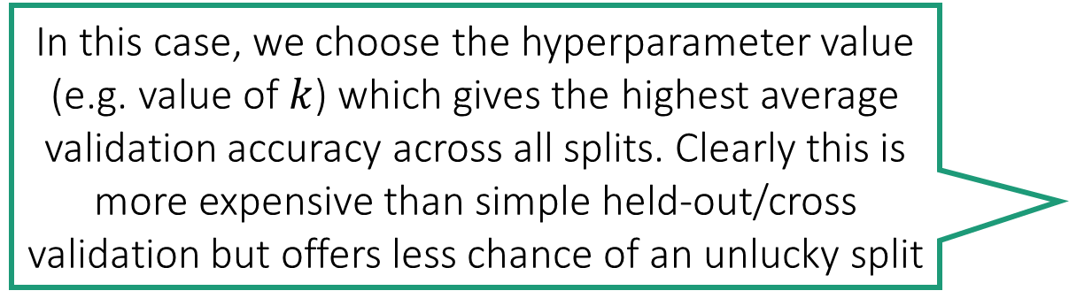
Multi-fold Cross Validation
In this case, we choose the hyperparameter value (e.g. value of $k$) which gives the highest average validation accuracy across all splits. Clearly this is more expensive than simple held-out/cross validation but offers less chance of an unlucky split
Split 1
Split 2
Split 3
Train
Train
Train
Validation
Validation
Validation

Slide 7
Decision Trees
A Decision Tree (DT) defines a hierarchy of rules to make a prediction
Root and internal nodes test rules. Leaf nodes make predictions
Decision Tree (DT) learning is about learning such a tree from labeled data
Root Node
Body
temp.
Warm
Cold
Non-mammal
An Internal Node
A Leaf Node
Gives
birth
Yes
No
Mammal
Non-mammal

Slide 8
Decision Trees for Supervised Learning
The basic idea is very simple
Recursively partition the training data into homogeneous regions
Within each group, fit a simple supervised learner (e.g., predict the majority label)
What do you mean by “homogeneous” regions?
Even though the rule within each group is simple, we are able to learn a fairly sophisticated model overall (note in this example, each rule is a simple horizontal/vertical classifier but the overall decision boundary is rather sophisticated)
A homogeneous region will have all (or a majority of) training inputs with the same/similar outputs

Slide 9





Decision Trees for Classification
5
NO
YES
Test input
$$x_{1}>3.5 ?$$
4
NO
YES
NO
YES
3
$$x_{2}>2 ?$$
$$x_{2}>3 ?$$
Feature 2 ($x_{2})$
2
Predict Red
Predict Green
Predict Green
Predict Red
1
1
2
3
4
5
6
Feature 1 ($x_{1})$
Remember: Root node contains all training inputs
Each leaf node receives a subset of training inputs
DT is very efficient at test time: To predict the label of a test point, nearest neighbors will require computing distances from 48 training inputs. DT predicts the label by doing just 2 feature-value comparisons! Way more fast!!!

Slide 10
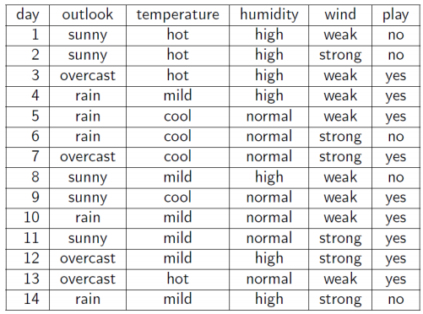
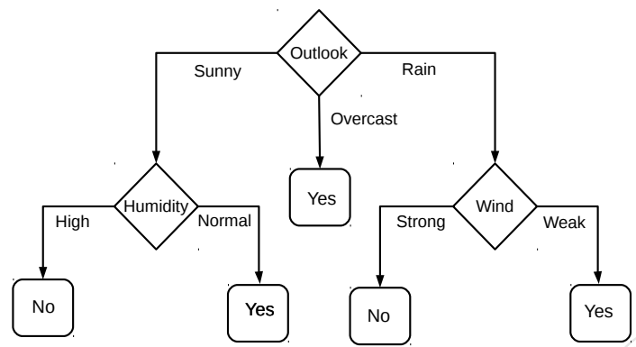
Decision Trees for Classification: Another Example
Deciding whether to play or not to play Tennis on a Saturday
Each input (Saturday) has 4 categorical features: Outlook, Temp., Humidity, Wind
A binary classification problem (play vs no-play)
Below Left: Training data, Below Right: A decision tree constructed using this data
Example credit: Tom Mitchell

Slide 11
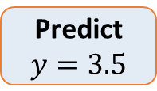


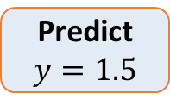

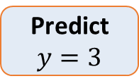

Decision Trees for Regression
Can use any regression model but would like a simple one, so let’s use a constant prediction based regression model
Another simple option can be to predict the average output of the training inputs in this region
4
3
2
1
NO
YES
$$x>4 ?$$
$$y$$
NO
YES
Predict $y=3.5$
$$x>3 ?$$
Predict $y=3$
Predict $y=1.5$
1 2 3 4 5
$$x$$
DT not only makes the problem more efficient at test time but also simplifies the problem because we have a simple model for each portion/region. A complete model comprises multiple simple models to construct a more sophisticated model (divide and conquer).
To predict the output for a test point, nearest neighbors will require computing distances from 15 training inputs. DT predicts the label by doing just at most 2 feature-value comparisons! Way more fast!!!

Slide 12
Decision Trees: Some Considerations
Usually, cross-validation can be used to decide size/shape
What should be the size/shape of the DT?
Number of internal and leaf nodes
Branching factor of internal nodes
Depth of the tree
Split criterion at internal nodes
Use another classifier?
Or maybe by doing a simpler test?
What to do at the leaf node? Some options:
Make a constant prediction for each test input reaching there
Use a nearest neighbor based prediction using training inputs at that leaf node
Train and predict using some other sophisticated supervised learner on that node
Usually, constant prediction at leaf nodes used since it will be very fast

Slide 13
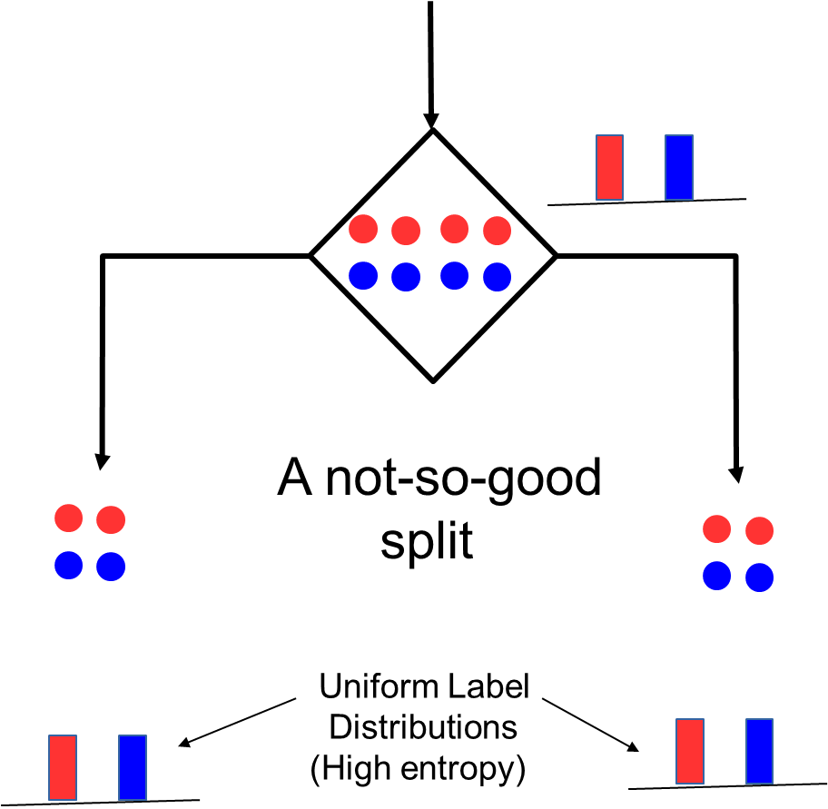
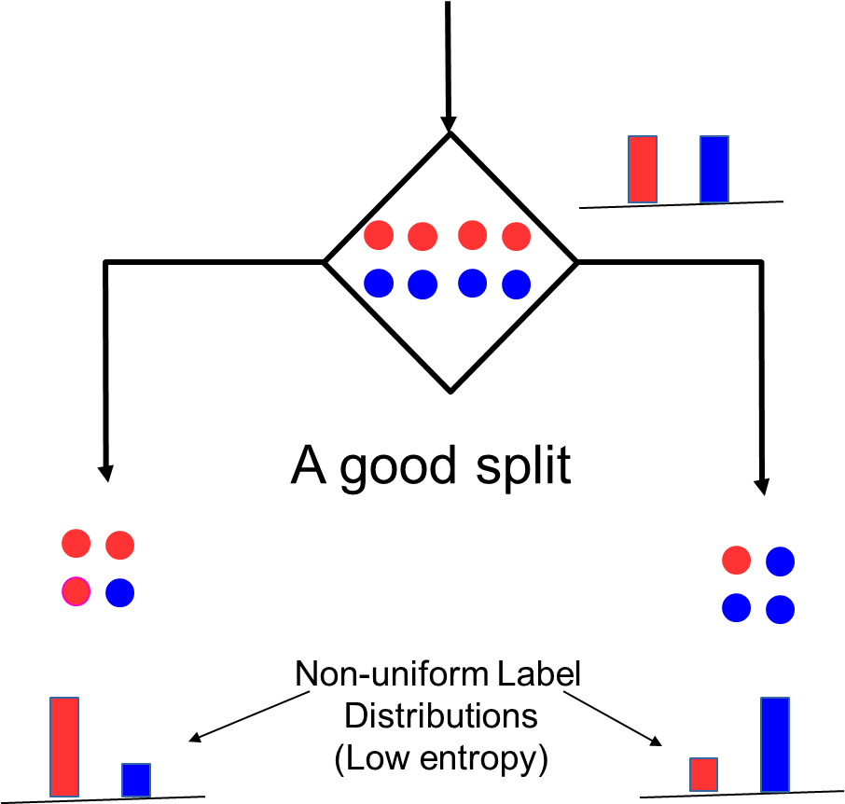
How to Split at Internal Nodes?
13
Recall that each internal node receives a subset of all the training inputs
Regardless of the criterion, the split should result in as “pure” groups as possible
A pure group means that the majority of the inputs have the same label/output
For classification problems (discrete outputs), entropy is a measure of purity
Low entropy ⇒ high purity (less uniform label distribution)
Splits that give the largest reduction (before split vs after split) in entropy are preferred (this reduction is also known as “information gain”)

Slide 14
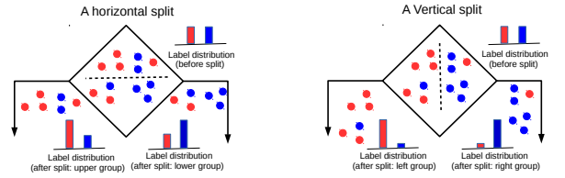
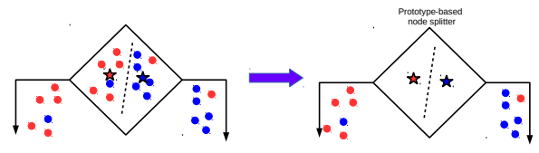
Techniques to Split at Internal Nodes?
14
Each internal node decides which outgoing branch an input should be sent to
This decision/split can be done using various ways, e.g.,
Testing the value of a single feature at a time (such internal node called “Decision Stump”)
Learning a classifier (e.g., LwP or some more sophisticated classifier)
With this approach, all features and all possible values of each feature need to be evaluated in selecting the feature to be tested at each internal node
(can be slow but can be made faster using some tricks)
DT methods based on testing a single feature at each internal node are faster and more popular (e.g., ID3, C4.5 algos)
DT methods based on learning and using a separate classifier at each internal node are less common. But this approach can be very powerful and are sometimes used in some advanced DT methods

Slide 15
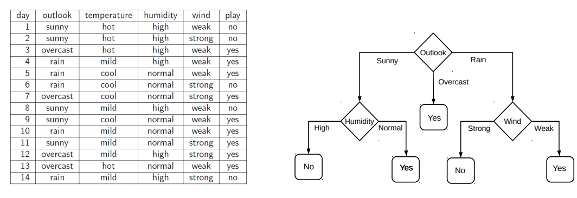
Decision Tree Construction: An Example
15
Let’s consider the playing Tennis example
Assume each internal node will test the value of one of the features
Question: Why does it make more sense to test the feature “outlook” first?
Answer: Of all the 4 features, it’s the most informative
It has the highest information gain as the root node

